Slide 1
SIGNALS
Continuous-time (CT) and Discrete-time (DT) Signals
Periodic Signals
Even and Odd Signals
Complex Exponential Signals
Some Common Signals
Power and Energy Signals

Slide 2
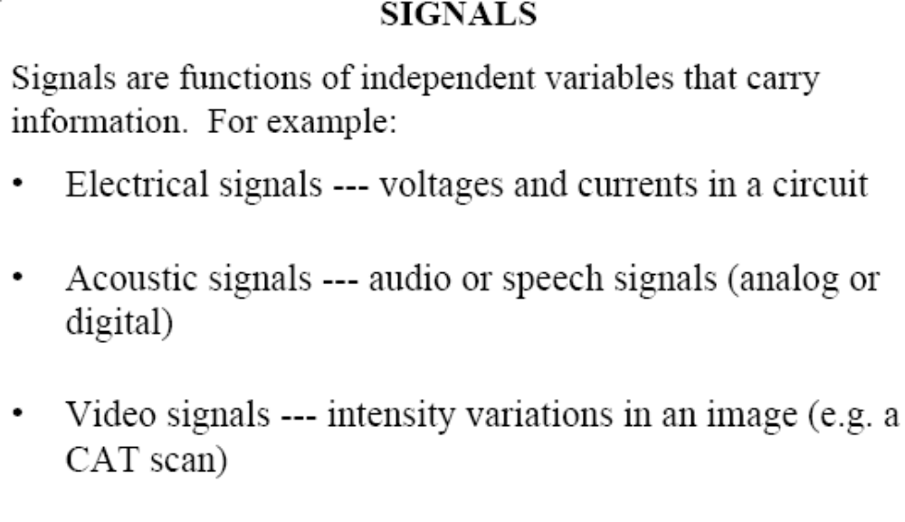

Slide 3
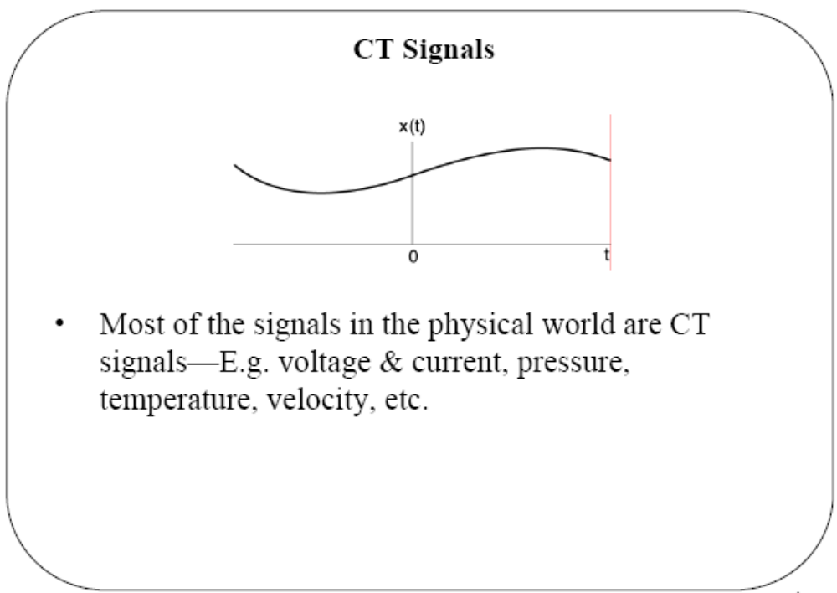

Slide 4
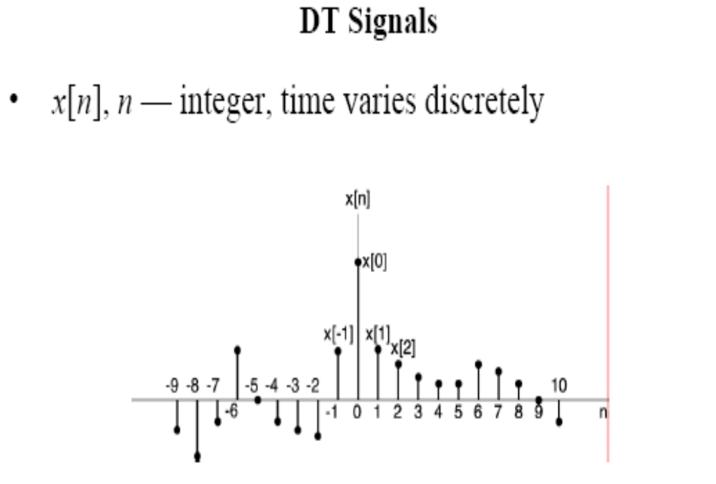

Slide 5
A DT signal has values for only discrete instants
of time, that is, the domain of t is a discrete set of numbers.
Such a signal is usually denoted as x(n) or x[n], instead of x(t),
where n is an integer.
A DT signal can also be obtained by sampling a CT signal.
In such cases, n may be replaced by kT, where k is an integer
and T is called the sampling interval. Hence, the sampled
signal is denoted by x(kT) or x(k) for simplicity.
A DT signal x(n) is often called a sequence.

Slide 6
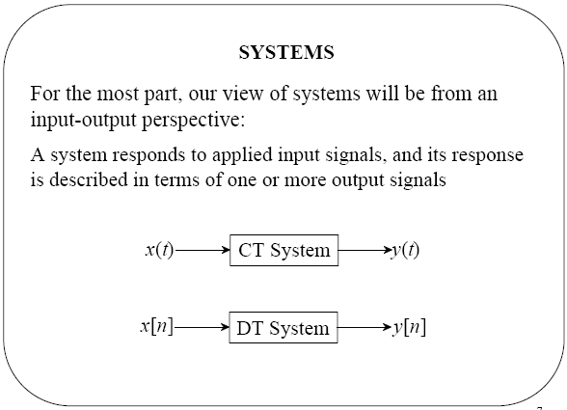

Slide 7
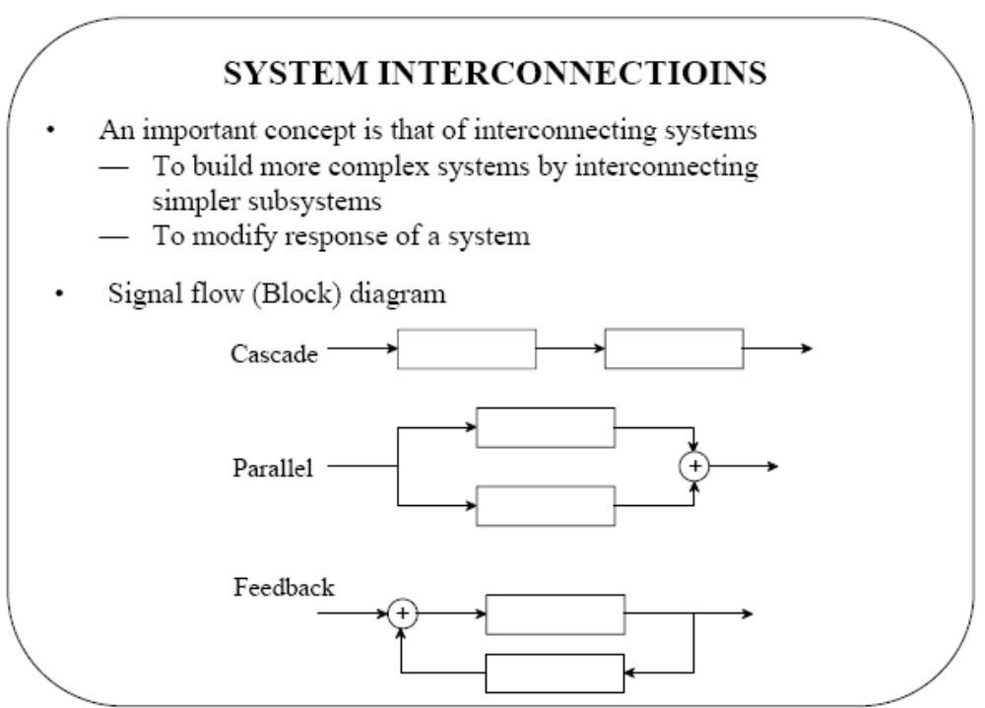

Slide 8
Periodic Signal: A CT signal x(t) is said to be periodic iff
x(t+T) = x(t) for all -∞ < t <∞
The smallest +ve value of T for which this holds is called the
period of the signal. For integer k, T may be replaced by kT.
Similarly, DT signal x[n] is said to be periodic if and only if
x[n+N] = x[n] for all -∞ < n <∞
The smallest +ve integer value of N for which this holds is
called the period of the signal.
Any signal that is not periodic is said to be aperiodic.

Slide 9
Examples
x(t)
x(t)
0 T 2T t
0 T t
saw-tooth
train of pulses
4 5 6
0 1 2 3
n
A sinusoidal sequence, x(n)=A sin(2πn/N) where the period is N=6

Slide 10
The most common example of a CT periodic signal is the
sinusoid described by
x(t) = A cos(ωt-φ)
where A is the amplitude, ω is the angular frequency in rad/sec,
φ is the phase in radians. The angular frequency is given by
ω = 2πf, where f is the frequency in hertz (or cycles/sec).
The period T, in seconds, is given by
T = 1/f = 2π/ω
Sum of x₁(t) = A₁ cos(ω₁t), x₂(t) = A₂ cos(ω₂t) is periodic, iff
the ratio T₂/T₁ is a rational number.

Slide 11
Example
Consider the three sinusoidal (periodic) signals,
x₁(t) = 10 sin3πt, x₂(t) = 20 sin7πt, x₃(t) = 10 sin32t
where ω₁= 2π/T₁=3π and the period for x₁(t) is T₁=2π/3π=2/3
and ω₂ = 2π/T₂ =7π and the period for x₂(t) is T₂=2π/7π=2/7
and ω₃ = 2π/T₃ =32 and the period for x₃(t) is T₃=2π/32= π/16
The ratio of T₂/T₁ is 3/7 which is a rational fraction and thus the
sum of x₁ and x₂ is also a periodic signal.
The ratio of T₃/T₁ is (π/16)/(2/3) is an irrational number and
therefore the sum of x₁ and x₃ will not be periodic.

Slide 12
Even and Odd Signals
A signal is said to be even if
x(t) = x(-t), x(n) = x(-n)
Note that an even function is symmetrical about the vertical axis.
A signal is said to be odd if
x(t) = -x(-t), x(n) = -x(-n)
An odd function is antisymmetric about the vertical axis.

Slide 13
Remember that sinkωt is odd while coskωt is even
for all values of k.
Any x(t) or x(n) signal can be expressed as a sum of
even and odd signals;
x(t) = x_{e}(t) + x_{o}(t), x(n) = x_{e}(n) + x_{o}(n),
where
x_{e}(t) = (1/2) [ x(t) + x(-t)], even;
x_{o}(t) = (1/2) [ x(t) - x(-t)], odd;
x_{e}(n) = (1/2) [ x(n) + x(-n)], even;
x_{o}(n) = (1/2) [ x(n) - x(-n)], odd;

Slide 14
Complex Exponential Signals
Recall the Euler’s relationship
exp(jθ) = e^{jθ} = cos θ + j sin θ
and a sinusoid can also be expressed as
A cos(ωt+φ) = Re[A e^{jωt} e^{jφ}] or A sin(ωt+φ) = Im[A e^{jωt} e^{jφ}]
or alternatively,
A cos(ωt+φ) = (A/2) [e^{jωt} e^{jφ} + e^{-jωt} e^{-jφ} ]
Note the periodic nature of the complex exponential,
e^{j(ωt+φ+2kπ)} = e^{j(ωt+φ)}

Slide 15
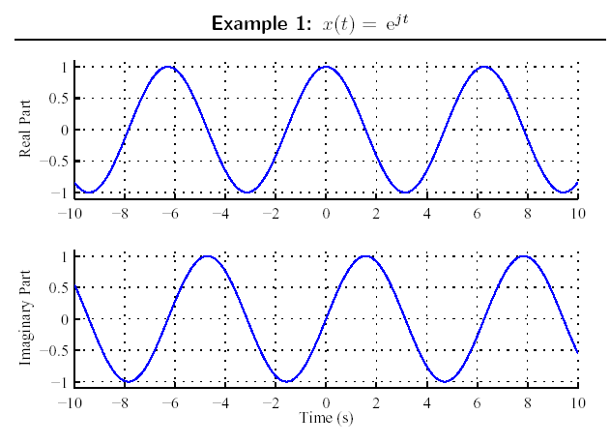

Slide 16
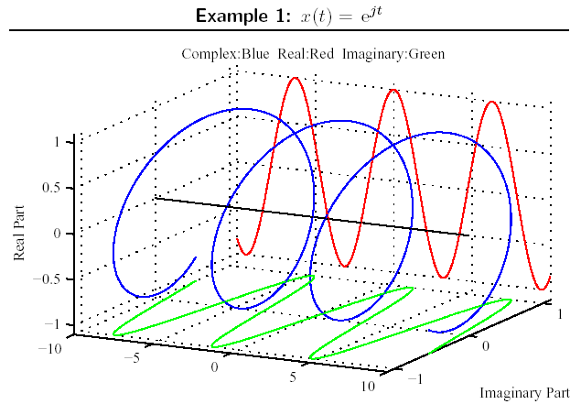

Slide 17
Similar to the CT case, the periodic DT signal in the form of
a complex exponential is expressed as
x(n) = A cos(2πn/N) = Re{Ae^{j(2πn/N)}} = Re{Ae^{jΩn}}
or x(n) = A sin(2πn/N) = Im{Ae^{j(2πn/N)}} = Im{Ae^{jΩn}}
where Ω= 2π/N is the angular frequency in radians. Note that
the period N is an integer and dimensionless quantity.
With a phase shift we have,
A cos(Ωn+φ) = (A/2){e^{jΩn} e^{jφ} + e^{-jΩn} e^{-jφ}}
Note that a distinct property of the DT complex exponential is
x(n) = e^{j(Ω+2π)n} = e^{jΩn} e^{j2πn} = e^{jΩn}
Need to consider only 2π interval; e.g. 0≤ Ω<2π or -π ≤ Ω<π

Slide 18
A second distinct property is related to the periodicity of DT
complex exponential; with period N>0,
e^{jΩ(n+N)} = e^{jΩn} => e^{jΩN} = 1 => ΩN = 2πm => Ω/2π = m/N
where m is also an integer, i.e. Ω/2π is a rational number.
If m and N have no common factors then the fundamental frequency
is
2π/N = Ω/m
and the fundamental period is given by
N = m (2π/Ω)
Note that CT x(t)=x(t+mT) is periodic for integer m and any real
T (need not be integer) whereas DT x(n)=x(n+mN) is periodic
for integers m and N.

Slide 19
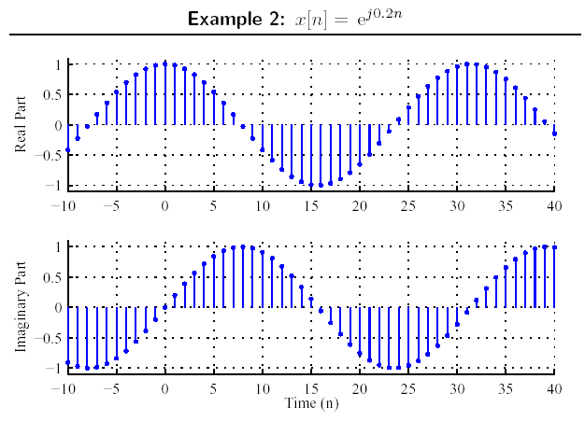

Slide 20
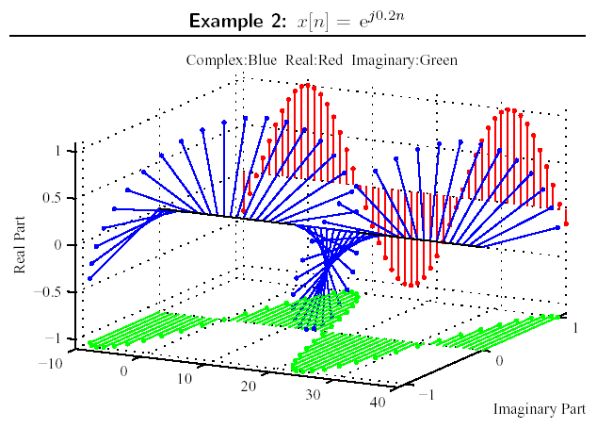

Slide 21
DT complex exponential sequence is defined as
x(n) = C α^{n} or x(n) = C e^{βn}
where α=e^{βn} and C, α are, in general complex.
Real exponential sequence: C, α are real quantities.
α>1
0<α<1
n
n
-1<α<0
α<-1
n
n

Slide 22
Some Common Signals
The unit step signal
{ 0 t < 0
u(t) = {
{ 1 t > 0
At t=0 the value of function jumps
0 to 1; it is discontinuous.
The unit step sequence
{ 0 n < 0
u(n) = {
{ 1 n ≥ 0
x(t)
1
t
0
x(n)
1
2
n
0
1

Slide 23
Integration of unit step gives unit ramp function r(t) as
r(t) = t for t ≥ 0
A ramp signal with slope m
is mr(t).
r(t)
t
0
t
Note that some other signals may generated by these singularity functions, namely u(t) and r(t).
DT unit ramp function is defined as r(n) = n for n≥0.
r(n)
n
0
0

Slide 24
Example
Signals generated by singularity functions.
(a) Rectangular pulse with duration T
and height A starting at t = t₀ can be
expressed as
x(t) = A u(t-t₀) – A u(t-t₀ -T)
x(t)
A
t₀
t₀+T
t

Slide 25
(b) Triangular pulse is expressed by
x(t) = (2A/T) [r(t - t₀) - 2r(t-t₀ - t/2) + r(t - t₀ -T)]
x(t)
A
t₀ t₀+T/2 t₀+T t

Slide 26
Unit Impulse
An important singularity function is the impulse or delta
function denoted by δ(t), integration of which gives u(t);
_{t}
u(t) = ∫_{-∞} δ(τ) d τ running integral
Alternatively, the unit impulse is given by the time derivative
of the unit step; δ(t)=du(t)/dt
δ_{ε}(t)
Properties of the impulse:
1. δ(t) = 0 for t ≠ 0
2. ∫_{-∞}∞ δ(τ) d τ = 1
The area under the impulse
is unity
1/2ε
-ε 0 ε
t
ε→0 => δ_{ε}(t) → δ(t)

Slide 27
DT unit impulse sequence, δ(n)
The process of integration is replaced with summation,
_{n}
u(n) = ∑_{-∞} δ(m) (running sum)
DT unit impulse is the first difference of the step sequence;
δ(n) = u(n) – u(n-1)
DT unit impulse defined as
{0 n ≠ 0
δ(n) = {
{ 1 n = 1
1
δ(n)
0
n

Slide 28
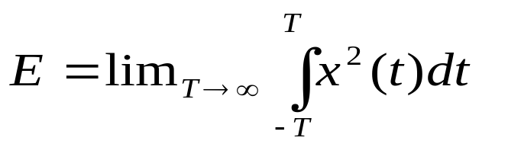
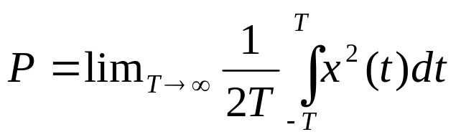
Power and Energy Signals
The energy content of a signal x(t) is given by
and the average power by
Note that if x(t) is the current (A) flowing in a 1 Ohm resistor then E is the total energy (Joules) dissipated and P is the average power (Watts) content in the signal

Slide 29
If the average power content is finite and positive, its energy
content will be infinite.
Similarly, if the energy content is finite , then its average power
content must be zero:
x(t) is a power signal if and only if its average power content P
is finite and positive, implying that its energy content is infinite.
(ii) x(t) is an energy signal if and only if its energy content E is
finite implying that its power content is zero.
(iii) If x(t) does not satisfy either of the two conditions stated
above, then it is neither a power nor an energy signal.

Slide 30
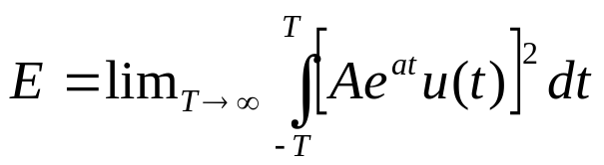
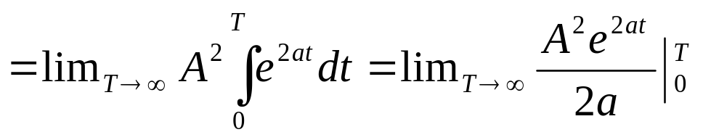
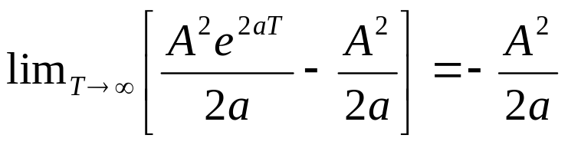
Example: Consider, x(t) = A e^{at} u(t) where u(t) is the unit step
and A, a are constants with a < 0.
=
Note that a<0 and E is +ve and finite. So this is an energy signal.
If a=0, x(t)=A u(t) and

Slide 31
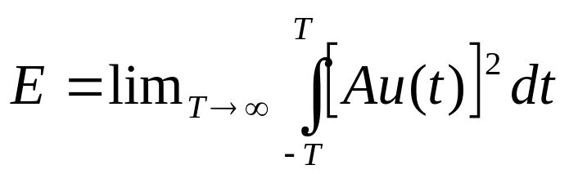
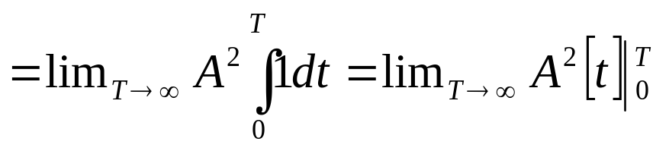
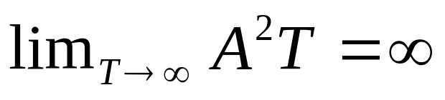
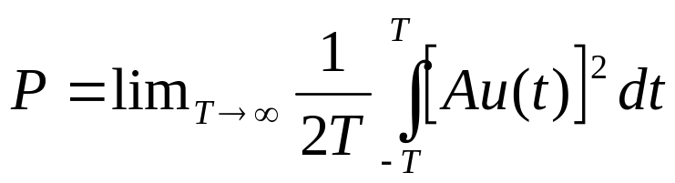
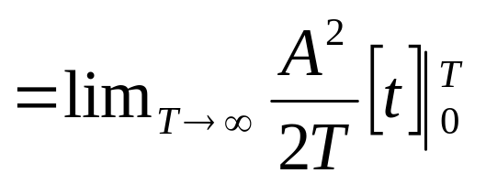
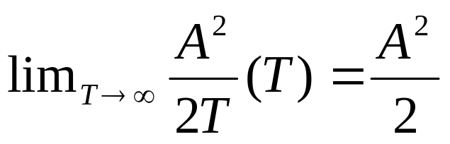
=
and
=
As P is finite, Au(t), i.e. the step function is a power signal.

Slide 32
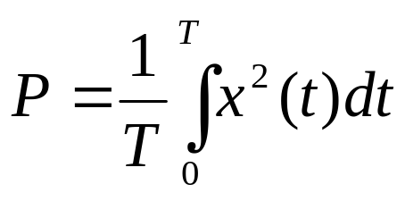
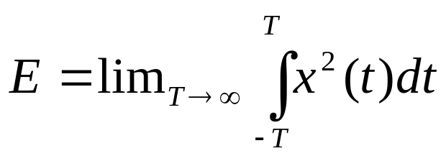
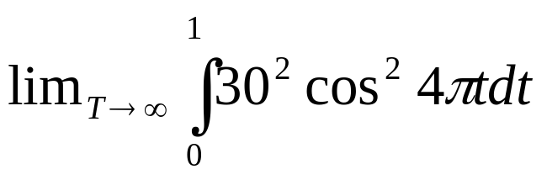
The average power content of a periodic signal x(t) with period
T can be determined by performing the integration over one
complete cycle,
Example: Consider
x(t) = 30 cos4πt[u(t) – u(t-1)]
=

Slide 33
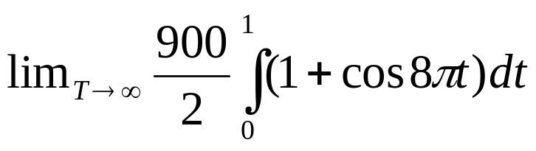
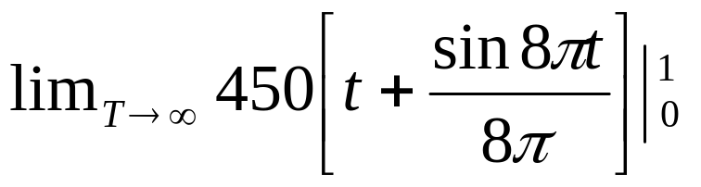
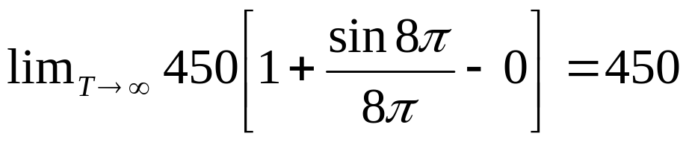
=
=
=
As E is finite, the considered x(t) is a energy signal.

